Slide 2
Automated Testing in Jenkins

Slide 3

By the end of this lesson, you will be able to:
Explain automation testing
Select appropriate tool for your application
Generate and display test reports
Work with Cobertura and Clover
Implement acceptance and performance testing

Slide 4
Jenkins as an Automated Testing Tool

Slide 5

What Is Automated Testing?
Test automation is the use of software to control the execution of tests and the comparison of actual and predicted outcomes.
One of the most efficient ways to perform automated testing is to write test scripts first using approach techniques, like Test-Driven Development (TDD) or Behavior-Driven Development (BDD).
BDD framework,Cucumber, presents acceptance test in such a way that testers, product owners, and end users easily understand.
During the test phase, Jenkins plays a major role in the Agile project.. It provides various plugins for different testing tools to integrate and automate tests during builds before deployment.
Notes:
Trainer Notes:
Explain all the points to the learner

Slide 6

Testing Tools
There are many unit testing tools with the xUnit family for various languages, like Java, C#, C, or C++.
JUnit is considered as a standard testing tool for unit tests of Java, although TestNG is another popular Java unit testing framework.
NUnit is a testing framework that proposes similar operations like Junit.
For C/C++, there is CppUnit, whereas PHP developers use PHPUnit.
Notes:
Trainer Notes:
Explain all the points to the learner

Slide 7
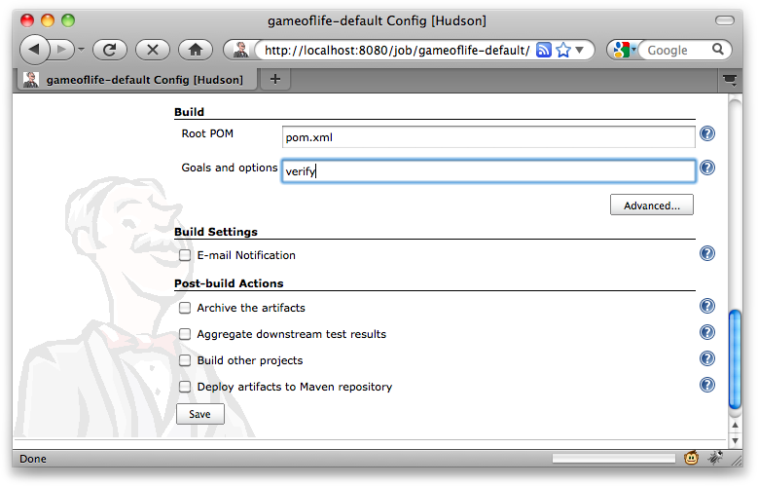
Configuring Test Reports in Jenkins
Jenkins doesn’t require any plugin or external dependency for generating test reports. Below are the different changes to be made in the job properties for different frameworks:
For Maven projects, invoke the goals field and type verify as shown in the figure below:
Notes:
Trainer Notes:
Explain all the points to the learner

Slide 8
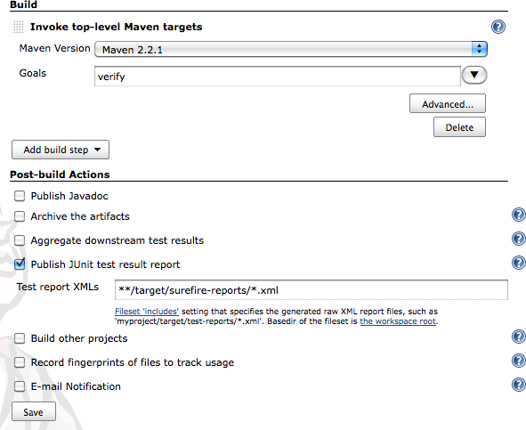
Configuring Test Reports in Jenkins
For free style project, configure tests in the Post Build Actions section and tell Jenkins to publish the test report as shown in the figure:
Directory of the test report XML will depend on the project. For a Maven project, a path like **/target/surefirereports/*. pom.xml is used.
For an Ant-based project, report file location will depend on how you configured the Ant JUnit task.
Notes:
Trainer Notes:
Explain all the points to the learner

Slide 9
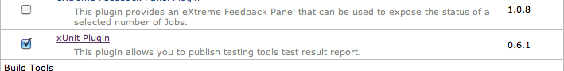
Configuring Test Reports in Jenkins
For Java projects, regardless of the testing framework, Jenkins has in-built configurations for configuring test reports.
If you are using Jenkins for non-Java projects, you need to install the xUnit Plugin.
This plugin helps Jenkins process test reports from non-Java tools. It supports MSUnit and NUnit (for C# and other .NET languages), UnitTest++ and Boost Test (for C++), PHPUnit (for PHP).
Notes:
Trainer Notes:
Explain all the points to the learner

Slide 10
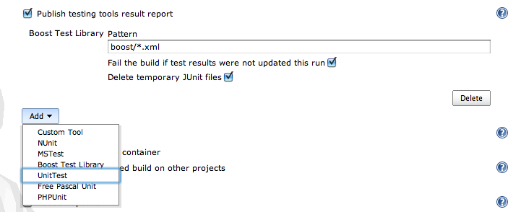
Configuring Test Reports in Jenkins
After installing xUnit Plugin, configure the reports in the Post-build Actions section.
Check the Publish testing tools result report checkbox and enter the path to the XML reports generated.
Jenkins will convert these reports to JUnit reports as soon as the build job runs to display in Jenkins.
Notes:
Trainer Notes:
Explain all the points to the learner

Slide 11
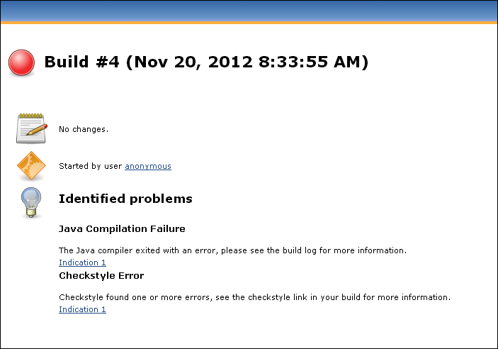
Displaying Test Results
In Jenkins, a failed build (indicated by a red ball) indicates test failures, such as a compilation error. The below screenshot shows the build failure in Jenkins:
Notes:
Trainer Notes:
Explain all the points to the learner

Slide 12
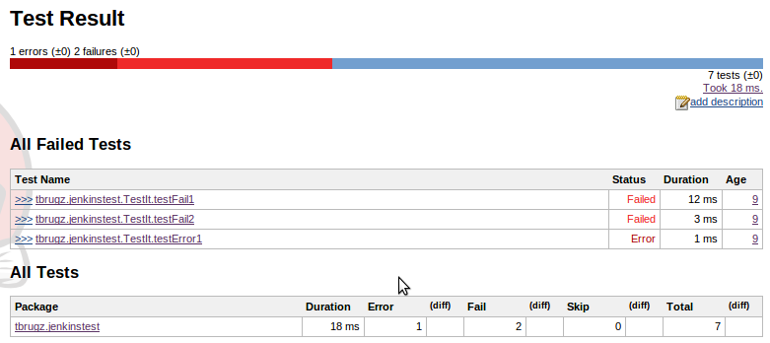
Displaying Test Results
Jenkins understands Maven project structures and initially shows a summary view of test results per module. The same is shown in the below screenshot:
Notes:
Trainer Notes:
Explain all the points to the learner

Slide 13
Generating Test Results
Problem Statement: You are given a project to generate and display test results in Jenkins.
Steps to perform:
Login to Jenkins
Adding Junit dependencies and classes in Maven project
Creating Jenkins job for Maven
Notes:
Trainer Notes:
Explain the objective

Slide 14
Code Coverage with Cobertura

Slide 15
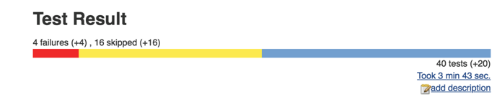
Ignoring Tests
Jenkins can identify the different tests that are ignored or failed. Below is an example of ignored test which uses @ignore annotation to indicate the compiler that a particular test is ignored. Jenkins also displays the information of the skipped tests as shown below:
@Ignore("Pending more details from the BA")
@Test
public void cashWithdrawalShouldDeductSumFromBalance() throws Exception {
Account account = new Account();
account.makeDeposit(100);
account.makeCashWithdraw(60);
assertThat(account.getBalance(), is(40));
}
Notes:
Trainer Notes:
Explain all the points to the learner

Slide 16

Code Coverage
Code coverage provides the information on parts of code in the application that were executed during the tests. It is an efficient way to identify the code that has not been tested during the execution of the application.
Code coverage analysis is a CPU and memory-intensive process.
Run code coverage operations in a separate Jenkins build job after unit and integration tests are built successfully.
There are many code coverage tools available in Jenkins through dedicated plugins, such as:
For Java, it is Cobertura, Emma, JaCoCo and Clover
For .NET, it is NCover
Notes:
Trainer Notes:
Explain all the points to the learner

Slide 17

JaCoCo
JaCoCo is a code java-based code coverage tool. It provides access to the JaCoCo runtime agent to analyze coverage data and generate code coverage report.
JaCoCo is an open source toolkit that is distributed under Eclipse Public License.
JaCoCo uses counters to calculate coverage metrics that are created based on the byte code of java files.
The data derived from the byte code is mapped with the source code to the lowest granularity.
Notes:
Trainer Notes:
Explain all the points to the learner

Slide 18
Measuring Code Coverage with JaCoCo
Counter divide the code into smaller unit based on the byte code data. Below are the four major classifications of data derived from Java byte code:
Instructions (C0 Coverage)
It is the smallest piece of byte code data mapped to the source code. It is an independent metric from the source formatting.
Cyclomatic Complexity
It indicates the complexity of the non-abstract methods, classes, and packages. This helps in determining number of unit test cases required.
Branches (C1 Coverage)
It covers the data from conditional statements and integrated branches in the source code. However, exception handling is not considered as a branch.
Notes:
Trainer Notes:
Explain all the points to the learner

Slide 19
JaCoCo with Maven
<build>
<plugins>
<plugin>
<groupId>org.jacoco</groupId>
<artifactId>jacoco-maven-plugin</artifactId> <version>${jacoco.version}</version>
<executions>
<execution>
<goals> <goal>prepare-agent</goal> </goals>
</execution>
<execution>
<id>report</id>
<phase>prepare-package</phase>
<goals> <goal>report</goal> </goals>
</execution>
</executions>
</plugin>
</plugins>
</build>
As JaCoCo is a Java-based code coverage tool, it can be easily integrated with Jenkins and Maven.
For Jenkins, navigate to Manage Plugins-> search for JaCoCo Plugin, and install the same.
Once Jenkins is set up, add the given code in pom.xml file to integrate JaCoCo with Maven project.
A maven job in Jenkins can handle the build and generate corresponding report for code coverage.
Notes:
Trainer Notes:
Explain all the points to the learner

Slide 20
Code Coverage with JaCoCo
Problem Statement: You are given a project to perform code coverage using JaCoCo.
Steps to perform:
Login to Jenkins.
Add JaCoCo plugin in Jenkins.
Add JaCoCo in Maven.
Create Jenkins job for Maven.
Notes:
Trainer Notes:
Explain the objective

Slide 21
Code Coverage with Clover

Slide 22

Introduction to Clover
Clover is a code coverage tool from Atlassian.
It works well for projects with Maven, Ant, and Grails.
Clover is open source and does not require a license tier.
Its source code can be downloaded from https://bitbucket.org/atlassian/clover.
To run Clover as open source, clone and compile locally.
It uses a shift-left approach to testing.
Clover works on Windows, Linux, and Mac OS X operating systems.
It is used in Java and Groovy for code coverage.
Redundant tests are noted through a per-test coverage feature.
Notes:
Trainer Notes:
Explain all the points to the learner

Slide 23
Adding Clover in Maven
To add Clover in a Maven project, add the following Maven dependency in pom.xml:
<build>
…
<plugins>
...
<plugin>
<groupId>com.atlassian.maven.plugins</groupId>
<artifactId>maven-clover2-plugin</artifactId>
<version>3.0.4</version>
<configuration>
<includesTestSourceRoots>false</includesTestSourceRoots>
<generateXml>true</generateXml>
</configuration>
</plugin>
</plugins>
</build>
This dependency enables and generates both HTML and XML reports, which include the combined data of a Maven project. It works even if the project contains different modules.
To integrate Clover in Jenkins, download and install Clover plugin from the Manage Plugin option.
Notes:
Trainer Notes:
Explain all the points to the learner

Slide 24
Running Clover
There are four major steps for executing Clover in the project:
Instrument your application
Run tests
Aggregate the test data
Generate reports
This is a slow process and should be executed in a different Jenkins using the following script:
$ clover2:setup test clover2:aggregate clover2:clover
Notes:
Trainer Notes:
Explain all the points to the learner

Slide 25
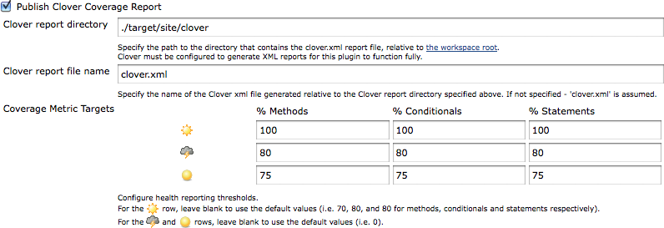
Running Clover
Once the build job is complete, set up the Clover reporting in Jenkins as shown below:
Select the Publish Clover Coverage Report and provide the path to the Clover HTML and XML report directory.
One can also define the metrics for Methods, Conditionals, and Statements.
Notes:
Trainer Notes:
Explain all the points to the learner

Slide 26
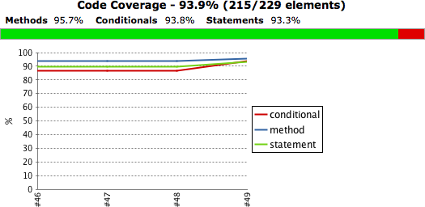
Clover Reports
Clover report is generated in the format shown below.
Notes:
Trainer Notes:
Explain all the points to the learner

Slide 27
Code Coverage with Clover
Problem Statement: You are given a project to implement code coverage using Clover.
Steps to perform:
Login to Jenkins
Adding Clover in Jenkins and Maven project
Creating Jenkins job for Maven
Configuring SCM
Setting build goals
Notes:
Trainer Notes:
Explain the objective

Slide 28
Acceptance and Performance Testing

Slide 29

Introduction to Acceptance Testing
Acceptance testing is used to evaluate the system's compliance with business requirements and assess its acceptability for delivery.
Acceptance testing provides valuable information to stakeholders about the status of a project.
Acceptance tests should be prototypes of the final project that demonstrates how the system works rather than test reports and other technical aspects.
Acceptance tests can be automated using conventional tools such as JUnit.
Behavior-Driven Development (BDD) frameworks can also be used as it is appropriate for the public-facing nature of acceptance tests.
Notes:
Trainer Notes:
Explain all the points to the learner

Slide 30
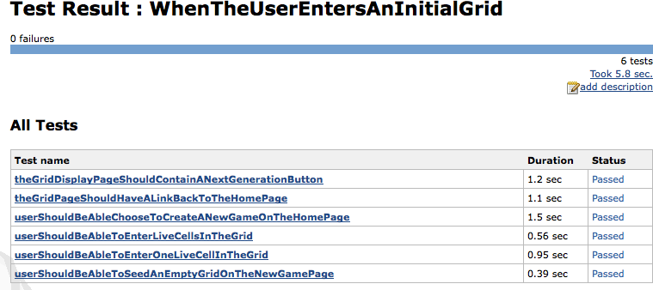
Acceptance Testing Report
Notes:
Trainer Notes:
Explain all the points to the learner

Slide 31

JMeter
Apache JMeter is an open-source software used for implementing load testing and measuring performance of websites.
It can be used to simulate a heavy load on a server, group of servers, and network or object to test their strength and analyze overall performance.
It is a stand-alone IDE that can be installed on the system.
It works with all major types of applications.
It has both CLI and graphical UI for performing operations.
It generates a complete and ready to present HTML reports.
It supports caching and offline analysis of test reports.
Notes:
Trainer Notes:
Explain all the points to the learner

Slide 32

Performance Testing with JMeter
Performance testing can be used for determining how quickly an application responds to requests with a given number of simultaneous user or how well the application copes with an increasing number of users.
JMeter simulates load on the application and measures the response time as the number of users and requests increase.
JMeter runs as a Swing application and allows tester to configure and edit the test scripts.
JMeter can run as a proxy and render the application on a browser, which generates initial version of the test script.
Jenkins doesn’t provide any plugin that is made specifically for Maven projects. However, one can install Maven-Ant plugin to call performance tests that are written in Ant.
Notes:
Trainer Notes:
Explain all the points to the learner

Slide 33
Integrate JMeter With Jenkins
Problem Statement: You are given a project to implement performance tests in Jenkins using JMeter
Steps to perform:
Install JMeter
Login to Jenkins
Adding performance plugin
Creating Jenkins job for JMeter
Notes:
Trainer Notes:
Explain the objective

Slide 34
One of the most efficient ways to perform automated testing is to write test scripts first using approach techniques.
For an Ant-based project, report file location will depend on how you configured the Ant JUnit task.
Run code coverage operations in a separate Jenkins build job after unit and integration tests are built successfully.
Acceptance tests should be prototypes of the final project that demonstrates how the system works, rather than test reports and other technical aspects.
JMeter can run as a proxy and render the application on a browser, which generates initial version of the test script.

Slide 36
What is automation testing?
1
Automating the test cases
Setting periodic builds in Jenkins
Both of the above
None of the above

Slide 37
What is automation testing?
1
Automating the test cases
Setting periodic builds in Jenkins
Both of the above
None of the above
A
Automation testing refers to automating the test cases when the application is compiled and built.

Slide 38
Which of the following is NOT a testing tool?
2
Selenium
Nunit
Junit
None of the above

Slide 39
Which of the following is NOT a testing tool?
2
Selenium
Nunit
Junit
None of the above
D
Selenium and Junit are used for Java, while Nunit is used for .Net testing.

Slide 40
What is Code Coverage?
3
Limiting the test cases
Adding execution constraints in Jenkins
Checking the parts of code executed during the execution of the test cases
None of the above

Slide 41
What is Code Coverage?
3
Limiting the test cases
Adding execution constraints in Jenkins
Checking the parts of code executed during the execution of the test cases
None of the above
C
Code coverage provides information on the parts of the code in the application that were executed during the tests.

Slide 42
Which of the following tool is better in terms of reporting between clover and cobertura?
4
Cobertura
Clover
JaCoCo
None of the above

Slide 43
Which of the following tool is better in terms of reporting between clover and cobertura?
4
Cobertura
Clover
JaCoCo
None of the above
B
Clover is more efficient in generating code coverage reports than Cobertura.

Slide 44
During an execution, which of the following annotations is used to ignore a test?
5
@nonexecutable
@ignore
@notatest
@untest

Slide 45
During an execution, which of the following annotations is used to ignore a test?
5
@nonexecutable
@ignore
@notatest
@untest
B
@ignore is the annotation used to ignore test while executing the application.

Slide 46
Testing Code Coverage
Problem Statement:
You’re a DevOps engineer at HungryHippo, a web- and mobile-based app development company that helps users order food from various restaurants in their cities. The company is trying to analyze the review sentiments and classify the reviews accordingly. The backend developers are developing a project that will extract words from reviews and analyze it to identify the sentiment. You are required to develop a microservice that counts the words in a given review and design a full Jenkins pipeline to compile a Spring Boot application with Maven, test with JUnit, and evaluate the code coverage using JaCoCo. Your pipeline has to compile this code, run a unit test, evaluate the code coverage, and publish the results. The pipeline is expected to scale and run seamlessly as more microservices are added to the project. The pipeline should be defined as a Jenkinsfile and be committed to the SCM.
Notes:
Trainer Notes: Explain the project to the learners, and instruct them to perform it after the lesson.

